Slide 1
Burkholderia genome plasticity
AA Pratama

Slide 2
Background
The genus Burkholderia encompasses mostly soil-, rhizosphere- and mycosphere-associated bacteria (Summer et al, 2007)
Members of this genus carry a veritable arsenal of genes on, mostly, large genomes (Haq et al, 2014)
Genome of Burkholderia spp. are among the largest genomes of the bacterial world. It appears that gene acquisition, resulting in such large genomes, has been promoted by HGT.

Slide 3
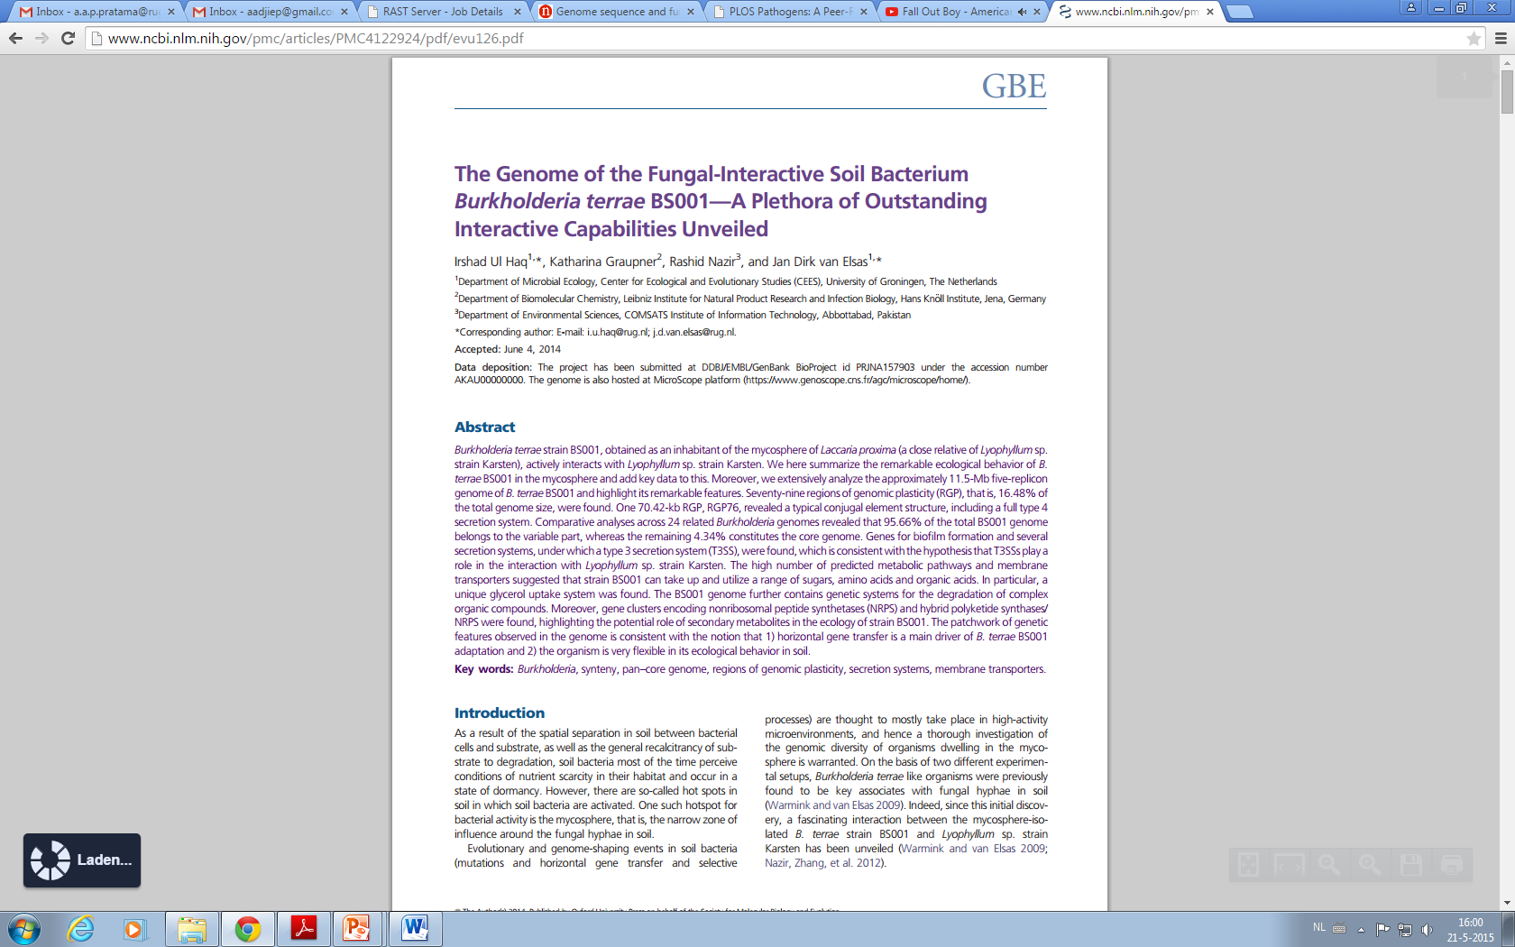
Background
Comparative analyses showed that 4.34% of the total Burkholderia terrae BS001 genome is the core genome, and 95.66% belongs to the variable part.
RGP76 contains some mobility genes, including seven integrases, and two phage family integrases.

Slide 4
Background
Eukaryotic
Bacteria
Mammalia
Plant
Archaea
4
Billion years
3
2
Origin
Possible fusion of Bacteria and Archaea, resulted in the first Eukaryotic ancestor,
Endosymbiosis of proteobacterium- origin of mitochondria
Symbiosis of Cyanobacteria- origin of plastids.
1
Frost el al, (2005).

Slide 5
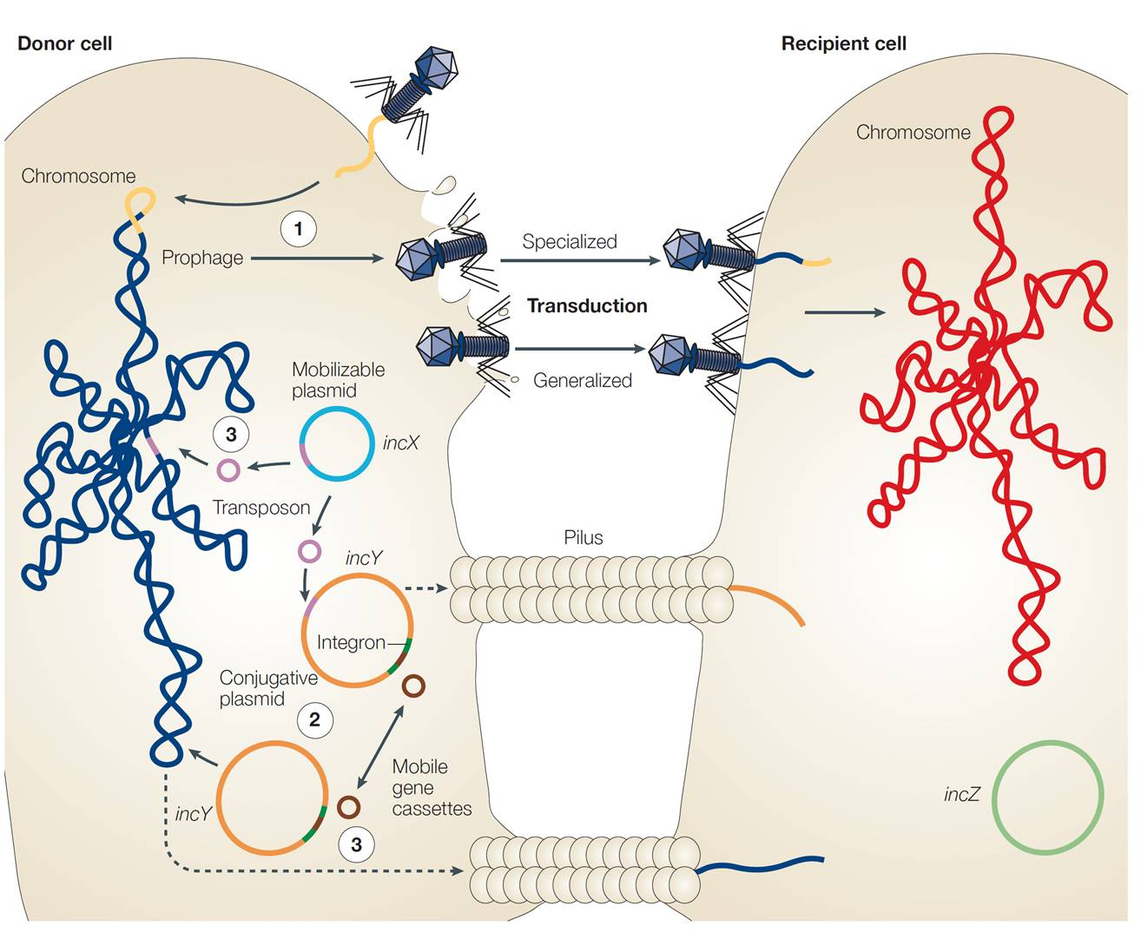
Phage impact on bacterial ecology

Slide 6
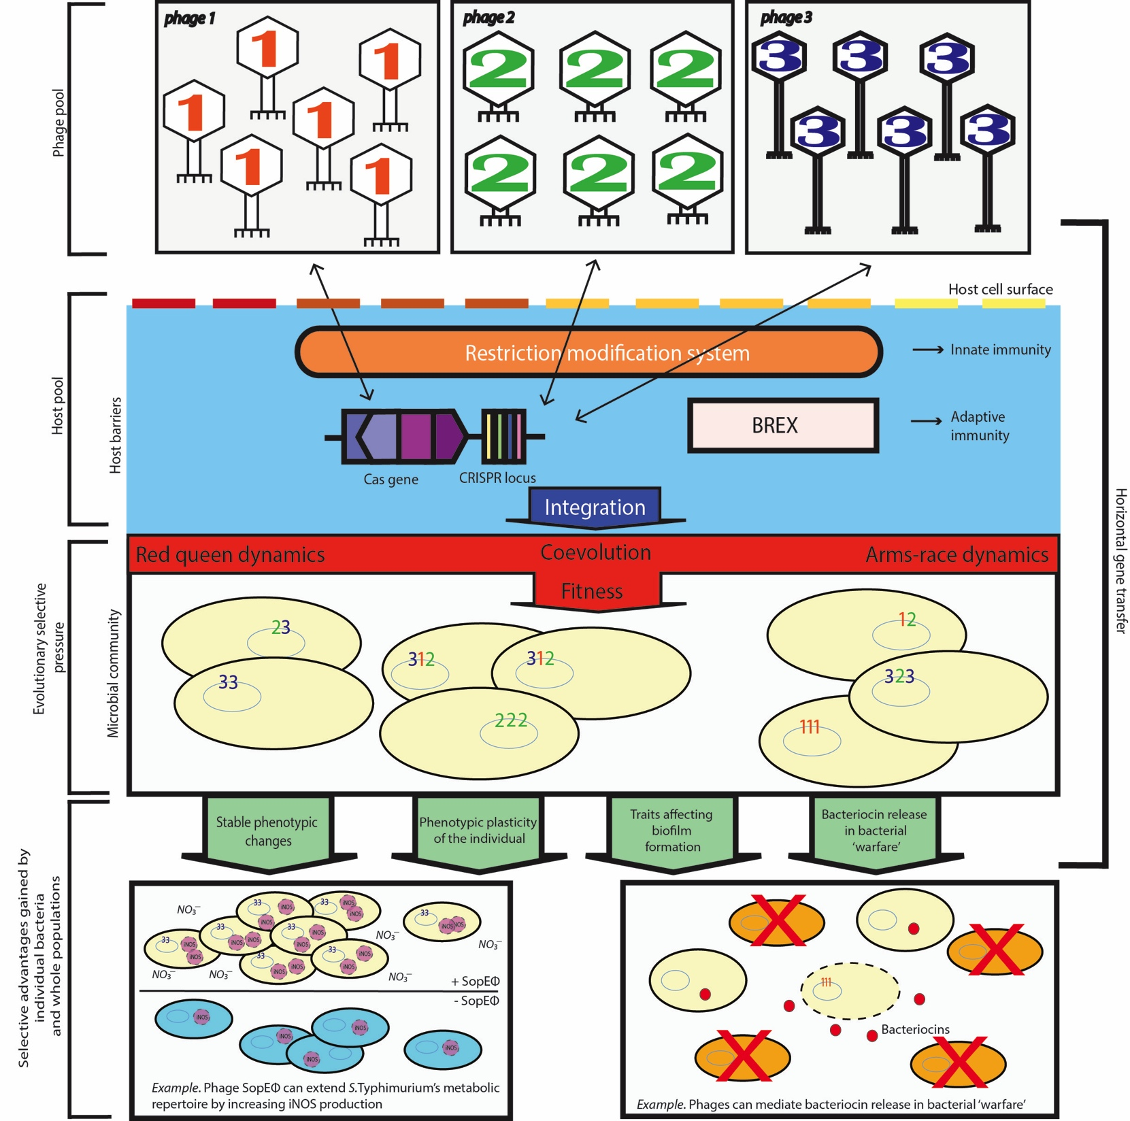
Phage impact on bacterial ecology
Antibiotic resistance (E.cili; kanamycin, tetracycline, ampicillin, and chloramphenicol.)
Communication (Clostridium difficile, phiCDHM1 )
Adverse environments (E.coli; K-12 BW2511 )
Cell metabolism (Synechococcus; S-PM2)
Phage defense (E.coli; Lambda)
Virulance factor (E.coli; stx-1/2)
Trends in Microbiol, in press (2016)

Slide 7
Project aims
How diverse is the genome between closely related bacterial isolates (Burkholderia)?
How significant phages shaped Burkholderia genome?

Slide 8
Methodology
Download sequence
Concatenate the genome
MCL Clustering
Regular expression
Core genome analysis
Blastall-vs-all analysis

Slide 9
Description
Beforehand: all fine is in the GitHub:
https://github.com/AAdjieP/Pratama_project.git
1 Burkholderia database: http://beta.burkholderia.com/strain/download (80 complete bacterial sequence)
2 Regular expression to simplified the header nt fasta files:
>ref|NZ_CP004118|gi|759565913|pseudocap|281460 [Burkholderia thailandensis E444 chromosome 2, complete sequence.]
>NZ_CP004118_B_thailandensis_E444
(>)\w+\|(\w+_\w+)\|\w+\|\d+\|\w+\|\d+ .(\w)\w+ (\w+) (\w+) .+
\1\2_\3_\4_\5

Slide 10
Description (cont.)
2 Regular expression to simplified aa sequence:
>Bcen_2989 ref|YP_622858.1|ref|YP_622858|gi|107025347| NADH:flavin oxidoreductase [Burkholderia cenocepacia AU 1054 chromosome 2, complete sequence.]
(>)\w+\w+ .+\| (.+\w+.+) \[(\w)\w+ (\w+) (\w+.\w+) .+
\1\3.\4_\5_\2
3 Transfer file from your computer to peregrine.hpc.rug.nl:
$ scp -r ./gbk/ p272779@peregrine.hpc.rug.nl:/home/pxxxxxx/

Slide 11
Description (cont.)
Challenges:
Overwhelmed by the huge data.
Regular expression >> python scripts

Slide 12
Description (cont.)
4 Make database for blast all-vs-all analysis:
$ module load BLAST/2.2.30-goolfc-2.7.11-Python-2.7.3
$ makeblastdb -in all_proteins.fasta -dbtype prot
5 Make scripts for job submission (BLAST):
#!/bin/bash
#SBATCH --job-name=blast-all-vs-all
#SBATCH --nodes=1
#SBATCH --ntasks-per-node=12
#SBATCH --time=2-23:00:00
#SBATCH --partition=himem
#SBATCH --mem=240GB
cd /home/p272779/scripts
module load BLAST/2.2.30-goolfc-2.7.11-Python-2.7.3
blastp -db all_proteins.fasta -query all_proteins.fasta -outfmt 6 -out all-vs-all.tsv -num_threads 12 -evalue 1e-5 -num_alignments 1

Slide 13
Description (cont.)
6 Job submission:
$ sbatch all-vs-all.sh
Submitted batch job 3636885
7 Check the submitted job:
$ squeue -u p272779
JOBID PARTITION NAME USER ST TIME NODES NODELIST(REASON)
$ ls
all-vs-all.tsv all_proteins.fasta.phr all_proteins.fasta.psq
all-vs-all.sh all_proteins.fasta all_proteins.fasta.pin slurm-3641612.out

Slide 14
Description (cont.)
Output:
B.cenocepacia_AU B.cenocepacia_HI2424 100.00 436 0 0 1 436 1 436 0.0 895
B.cenocepacia_AU B.cenocepacia_HI2424 100.00 306 0 0 1 306 1 306 0.0 613
B.cenocepacia_AU B.cenocepacia_MC0-3_short-chain 100.00 245 0 0 1 245 1 245 1e-173 483
B.cenocepacia_AU B.cenocepacia_MC0-3_NADH:flavin 100.00 360 0 0 1 360 1 360 0.0 724
B.cenocepacia_AU B.cenocepacia_MC0-3_alpha/beta 100.00 278 0 0 1 278 1 278 0.0 572
B.cenocepacia_AU B.cenocepacia_MC0-3_limonene-12-epoxide 100.00 129 0 0 1 129 1 129 8e-90 261
B.cenocepacia_AU B.cenocepacia_HI2424 100.00 399 0 0 1 399 1 399 0.0 820
B.cenocepacia_AU B.cenocepacia_HI2424 100.00 443 0 0 1 443 1 443 0.0 879
B.cenocepacia_AU B.cenocepacia_MC0-3_LysR 100.00 306 0 0 1 306 1 306 0.0 615

Slide 15
Description (cont.)
8 Transfer data from peregrine to computer:
In home (computer) directory:
$ cp pxxxxxx@peregrine.hpc.rug.nl:/home/pxxxxxx/scripts/all-vs-all.tsv ~/Documents/pcfb/Project
p272779@peregrine.hpc.rug.nl's password:
all-vs-all.tsv 100% 7641KB 1.1MB/s 00:07
$ cd ~/Documents/pcfb/Project/
$ ls
Final_report.docx all-vs-all.tsv faa_copy fna_copy
Report.docx faa fna gbk

Slide 16
Description (cont.)
9 Identify the core genome:
Core is 80% similarity in aa sequence
$ cd ~/Scripts
$ nano
#!/usr/bin/env python
Filename= "all-vs-all.tsv"
File= open(Filename, 'r')
Outfilename= "Outallvsall.tsv"
Outfile=open(Outfilename, 'w')
for line in File:
value =line.split('\t')
val = int(float(value[2]))
if(value >=80):
print line
Outfile.write(line)
File.close()
Outfile.close()

Slide 17
Description (cont.)
The expected results (above).

Slide 18
Challenges:
100% similarity in most data
Mistakes at any process.
Affected the results forwards.

Slide 19
Description (cont.)
10 MCL Clustering:
http://micans.org/mcl/index.html?sec_news
Installation:
$ cd ~/Downloads/mcl-14-137/
$ ./configure --prefix=$HOME/local
$ make install
$ cut -f 1,2,11 all-vs-all.tsv > all-vs-all.abc
$ mcxload -abc all-vs-all.abc --stream-mirror --stream-neg-log10 -stream-tf 'ceil(200)'-o all-vs-all.mci -write-tab all-vs-all.tab

Slide 20
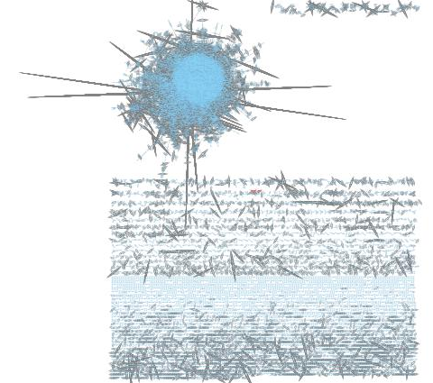
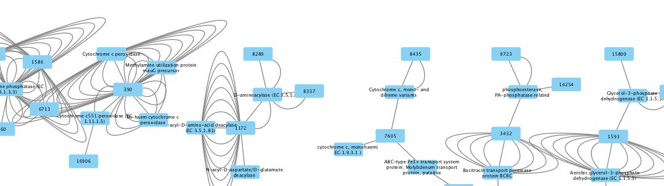
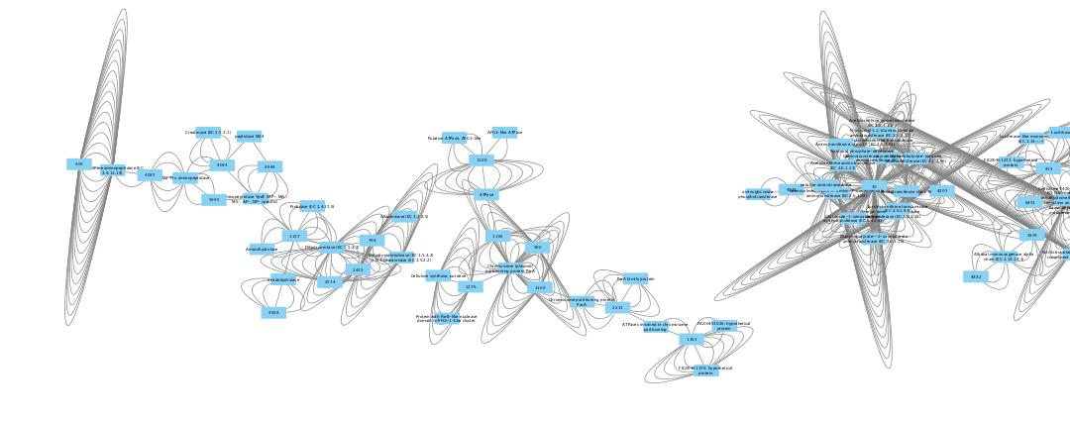
Clustering visualization:
Cytoscope program
Network that connecting and relationship Gene family clusters.

Slide 21
Thank you

